Slide 1
Credit Card Default Prediction
- Rohit Dhawale

Slide 2
Project analysis slide 2
Credit Card Default & Cost Fun Facts:
Unique due to individual circumstances
Servicing a defaulting customer is costly-
spend over $1,000/ defaulting account
Credit Card Default
Over 9 million Americans have
faced credit card defaults
Costs of defaults and delinquencies can ultimately lead to reduced profits..
Default impacts credit scores,
making it harder to access credit.
Defaults lower credit scores by 60-110 points,
impacting trust and market stability.
Total U.S. credit card balance: $1.031 trillion in Q2 2023.
Credit card interest rates: Highest at over 20% (since 1994)

Slide 3
Project analysis slide 2
Impact on Banks & Organizations:
Over 1.5 million bankruptcy filings were recorded
in the U.S. in 2020, some due to credit card defaults.
Banks now use sophisticated algorithms and data analytics to evaluate default risk
Effects
In 2020, the U.S. faced $11 billion in credit
card defaults
Credit card defaults can lead to up to a 2%
loss in annual revenues for issuers.
2008 global financial crisis showed the consequences
of not assessing borrowers' creditworthiness
Around 15% of credit card defaults are
linked to fraudulent activities.
Globally, non-performing loans accounted for around 4.4% of total loans in 2021.
Collection agencies can cost between 25% to 50% of the amount collected.

Slide 4
Way Forward:
Default Credit Card
Possible Outcomes
Default Prediction: Utilizing a comprehensive model to predict next month's customer defaulters and non-defaulters.
Early Detection: Designing a model to proactively identify customers likely to miss payments.
Debt Settlement: Identifying potential customers who can promptly settle their credit balances.
Payment Reliability: Assessing customers' ability to make timely credit card payments.
Happens when customers fail to adhere to the credit card agreement, by not paying the monthly bills

Slide 5




Business Question ?
What innovative strategies can be implemented to effectively reduce credit card defaults and minimize financial losses for lending institutions?
Business Proposal
Predict Credit Card Customer default
Data Driven Approach to risk assessment
Use comparative analysis with research paper
Use Predictive Modelling to address real world challenges.

Slide 6
Process Flow
Preparation of Data
Applying Models
Evaluation of Models
Comparing the applied Models
Finalize the best Model

Slide 7
Project analysis slide 4
Data Overview
LIMIT_BAL: Amount of credit (NT dollar).
Default_payment_next_month: Default Pay
PAY_AMT1 - PAY_AMT6: Amount of previous payment
SEX: Gender (male; female)
Tasks
Management Objectives
BILL_AMT1 – BILL_AMT6: Amount of bill statement
Numerical Features
Categorical Features
AGE:
MARRIAGE: (married; single; others)
EDCATION: graduate; university; high school; others
Customer Objectives
PAY_0 – PAY_6: History of past payment.
Resources
TARGET VARIABLE- Default Payment
A customer who will default next month

Slide 8
Highlighting arrears of the research paper
Addressing Imbalanced Dataset
Addressing no implementation of Hyperparameter Tuning
Experimenting on new models and metrices
Dataset
Metric
Hypertuning
Motivation
Experiment
Addressing Performance Metric Selection
Providing right set of risk management with altered outcomes

Slide 9
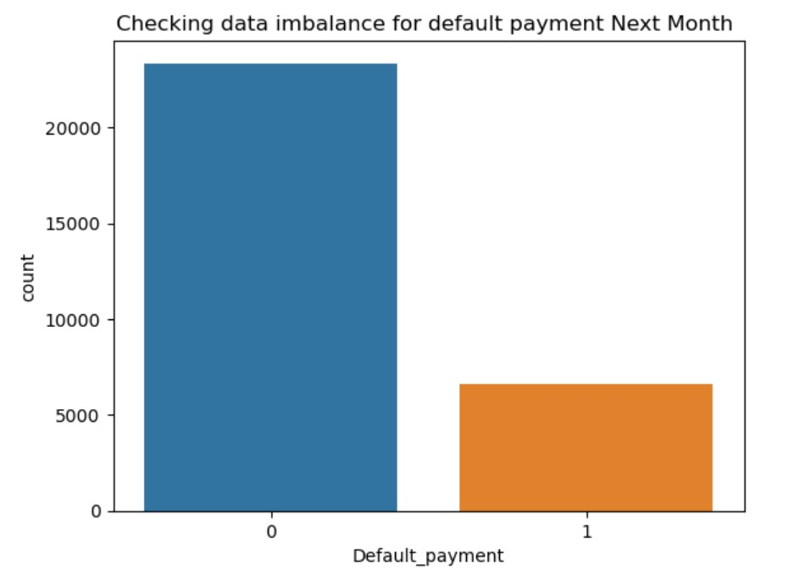
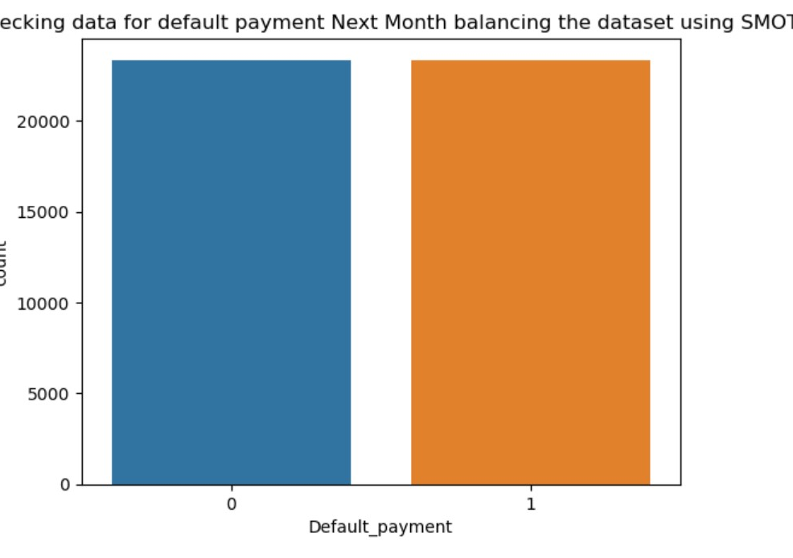
Description of the Data:
Dataset of Taiwan's credit card clients
23 features and 30,000 instances
6,626 (22.1%) being default cases.

Slide 10
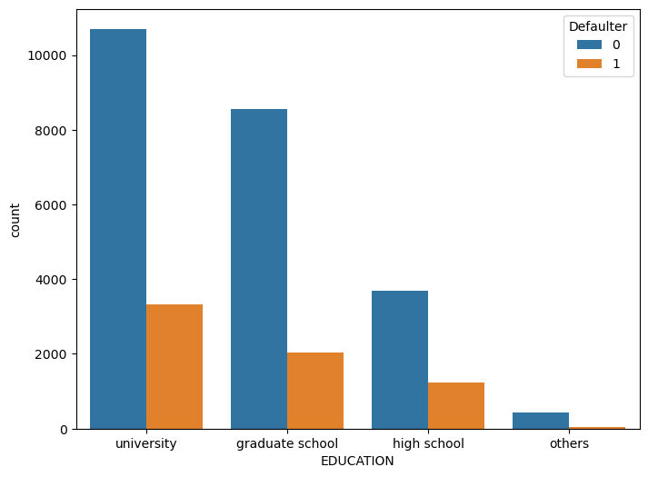
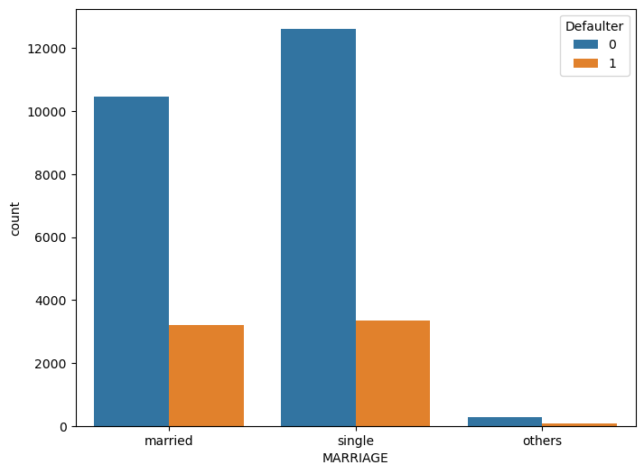
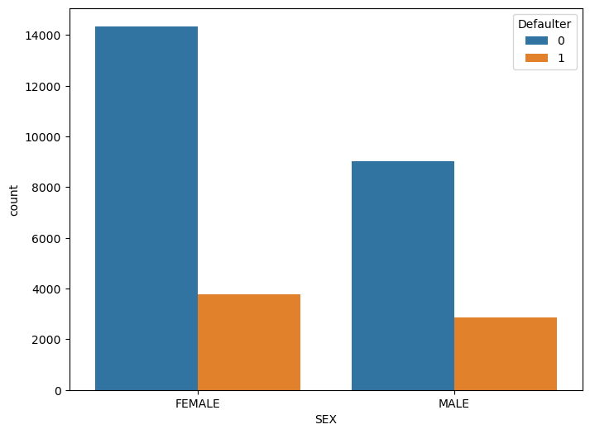
Description of the Data:
Overview of default customers based on –Education/Marriage /Sex

Slide 11
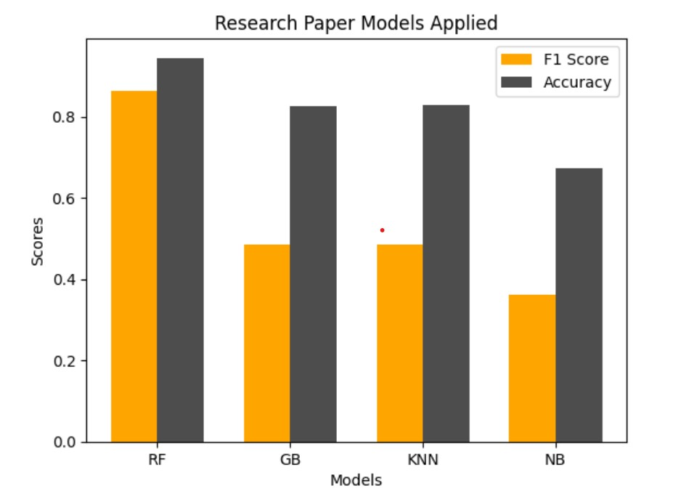
Models used in Research Paper

Slide 12
Models used in our Project
Naïve Bayes
KNN
Logistic Regression
Random Forest
Support Vector Classifier
Gradient Boost
Models Applied
ADA
XGBoost
Decision Tree
MLP
Notes:
© Copyright PresentationGO.com – The free PowerPoint and Google Slides template library

Slide 13
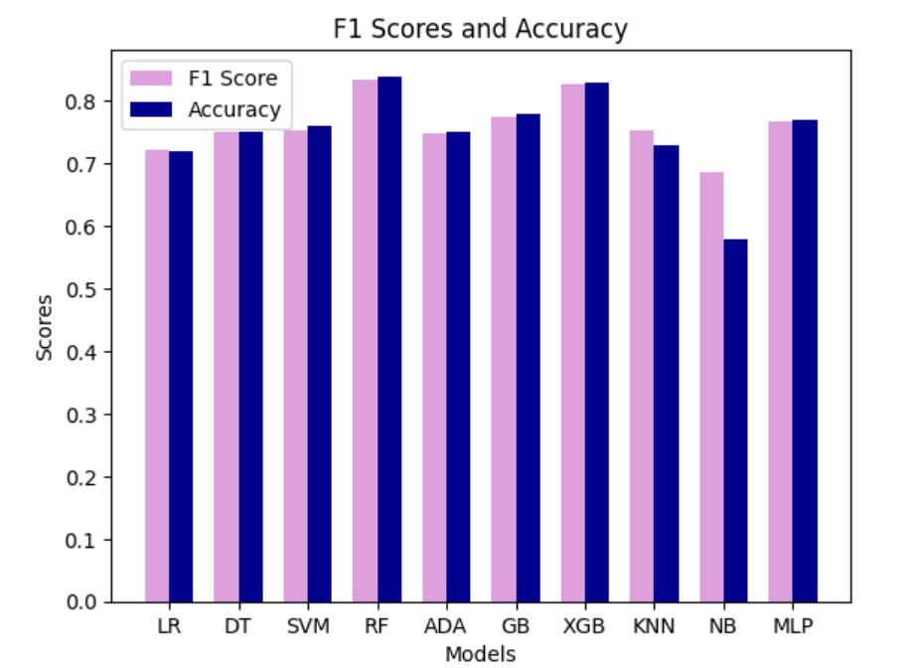
Models applied

Slide 14
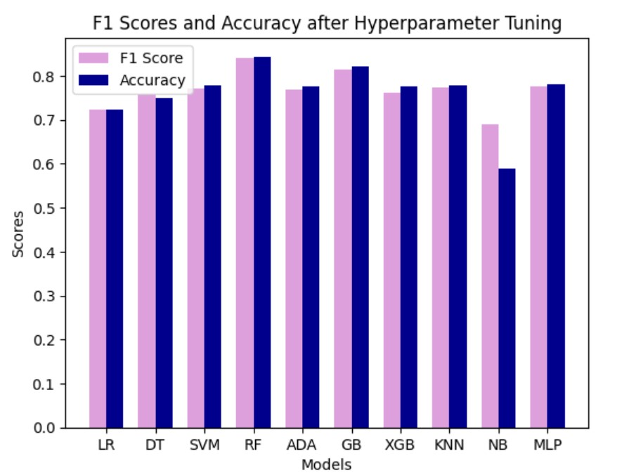
Fine Tune Results

Slide 15
Business Impact Summary
Chosen for balancing precision and recall.
Addresses critical issues of credit card defaults.
Minimizes false alarms and identifies potential defaults effectively.
F1 Score as Preferred Metric
Acknowledges cost implications for lending institutions.
Sensitive to false positives and false negatives.
Helps optimize customer interventions and prevent financial losses.
Cost Sensitivity
Considers the trade-off between precision and recall.
Allows customization of decision thresholds.
Aligns with the institution's risk tolerance and cost structure.
Threshold Adjustment
Reflects the real-world impact of credit card defaults.
Minimizes financial losses.
Protects the interests of lending institutions and cardholders.
Business Impact

Slide 16
Project analysis slide 8
Model Recommendation:
Reasons for Choosing Random Forest:
Conclusion
Performance: Random Forest outperforms other models with a higher F1-Score for your dataset, indicating superior predictive capability.
While XGBoost is a strong contender, Random Forest's slightly better performance, ease of use, and interpretability make it the preferred choice for your credit card payment default prediction problem.
Interpretability: Random Forest provides insights into feature importance, which can be crucial for regulatory compliance and stakeholder communication.
Ease of Use: It's straightforward to implement and handles various data types without extensive preprocessing, making it a practical choice.

